Slide 1
Module 3 Cloud computing services
Compute Services
Storage Services
Database Services
Application Services

Slide 2
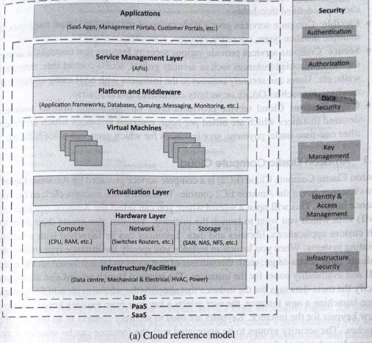

Slide 3
Cloud Reference Model
Infrastructure an facilities layer that includes physical infrastructure such as data centers, electrical & mechanical equipment etc.
Hardware layer includes physical compute, network and storage hardware
Virtualization layer partitions the physical hardware resources into multiple virtual resources that enabling pooling of resources
Computing services provided in the form of Virtual Machines (VMs) along with the storage and network resources
Platform and middleware layer provides standardized stack of services such as database service, queuing service, application framework and run-time environments etc.
Service Management layer provides APIs for requesting, managing & monitoring cloud resources
Application layer provides SaaS applications such as email, cloud storage application, management portals etc.

Slide 4
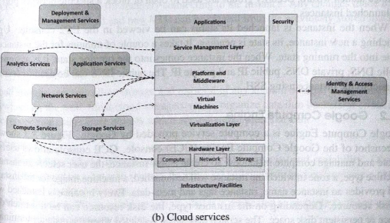

Slide 5
Compute Services
Provides dynamically scalable compute capacity in the cloud
Can be provisioned on demand in the form of virtual machines
Compute services can be accessed from web console that provides graphical user interface for provisioning, managing and monitoring these services
Cloud provider also provides APIs for various programming languages (e.g java, python etc.)
Features:
Scalable
Flexible
Secure
Cost effective

Slide 6
1. Amazon Elastic Compute cloud
EC2 is a compute service provides by Amazon
It provides secure and resizable compute capacity in cloud
Provides Scaling (scaling up or down) as per demand
It creates instances and launch them. Also mention type of instance e.g. micro, small, medium , large , so on…
Integrated with other services
Pay as per use
It supports for different OSs
Provides secure network by;
By selecting key-pair, which is used to securely connect to instance after it launches.
Security groups are associated with the instance

Slide 7
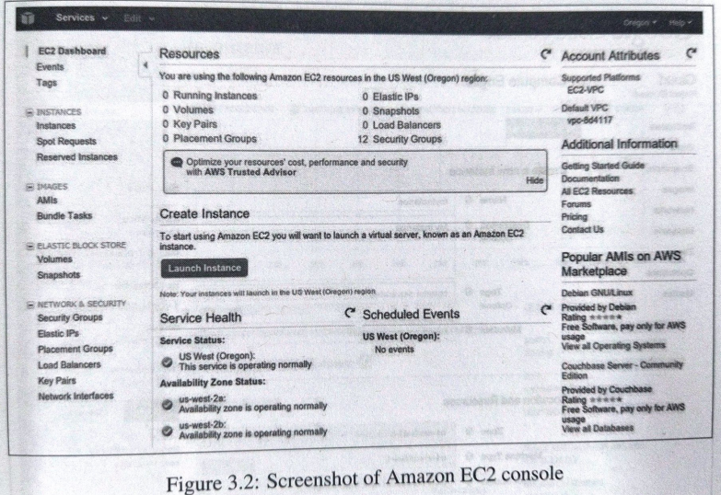

Slide 8
2. Google Compute Engine
Compute service provided by google
To create a new instance, the user selects an instance machine type, a zone in which the instance will be launched, a machine image for the instance and provides –instance name, tags and meta-data
Every instance is launched with disk resource
Types of disks:
Scratch disk space: This space is deleted when instance terminates
Persistent disk space: it live beyond the life of an instant
In and out traffic to instance is controlled by network option
Traffic between instances in same network, over any port and any protocol ,it provides SSH connections
For other connections, firewall rules are implemented

Slide 9
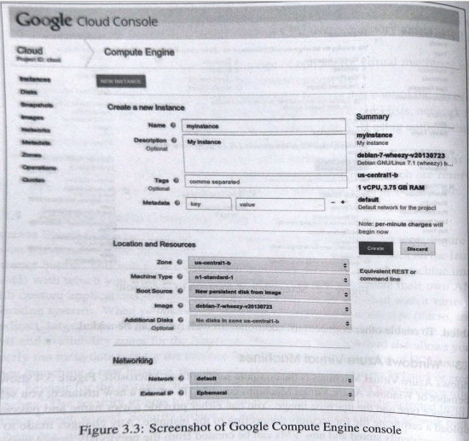

Slide 10
3. Windows Azure Virtual Machines
Compute service from Microsoft
To create a new instance
- Select instance type
- Select machine image
For security: username and password can be defined or upload a certificate file for securely connecting to the instance.
Any changes made to the VM are persistently stores
New VMs can be created from previously stored machine images

Slide 11
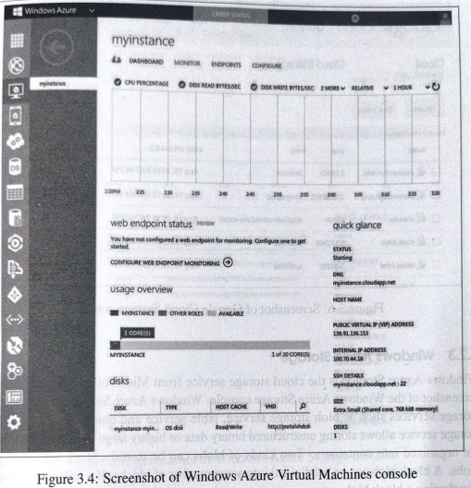

Slide 12
Storage Services
It allows storage and retrieval of any amount of data, at any time and from any location
Cloud storage services organizes data into buckets or containers
Features:
Scalability & Capacity
Replication
Access policies: ACL (Access Control Lists), bucket/container level policies etc.
Encryption: Encrypts all data stored in cloud storage
Consistency

Slide 13
1. Amazon Simple Storage Service (S3)
Cloud based data storage infrastructure
Highly reliable, scalable, fast, fully redundant, affordable storage infrastructure
Data organized on S3 is in the form of buckets
S3 console provides simple wizard for creating a new bucket and uploading files
It support any kind of file storage
While uploading following points can be mentioned:
Redundancy
Encryption options
Access permissions

Slide 14
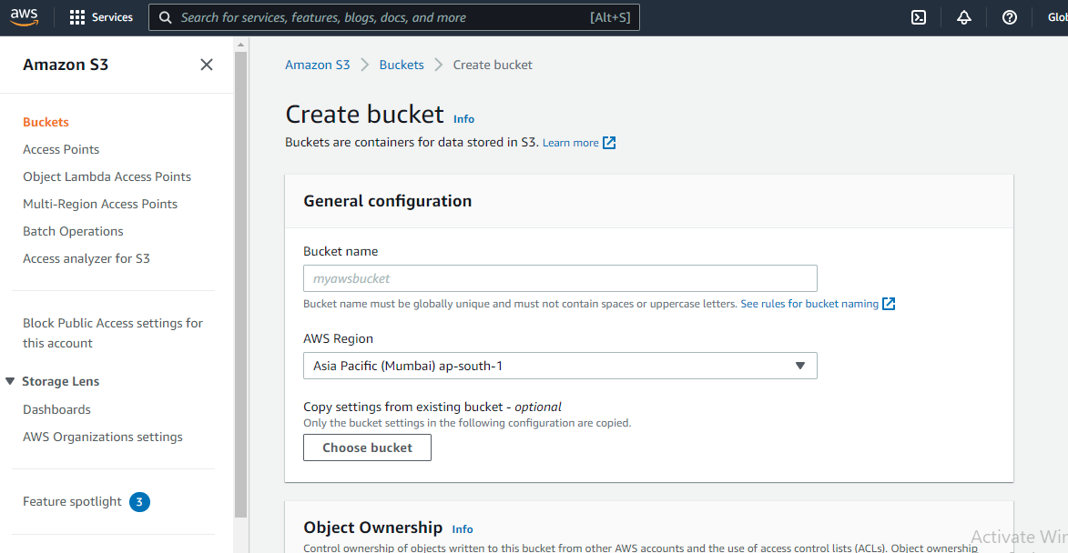

Slide 15
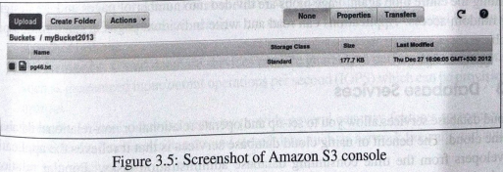

Slide 16
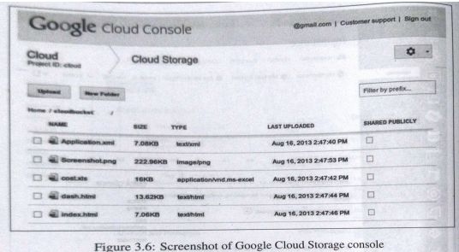
2. Google cloud storage
Objects in GCS are organized using buckets
ACLs are used to control access to objects and buckets
ACLs can be configured to share objects and buckets with the entire world, Google group, Google hosted domain or specific Google account holders

Slide 17
3. Windows Azure storage
Cloud storage service from Microsoft
It provides following storage services:
Blob storage service: Large amount of unstructured data
Table service: Non relational structure data
Queue service: Stores large number of messages that can be accessed from anywhere via authenticated call using http/https

Slide 18
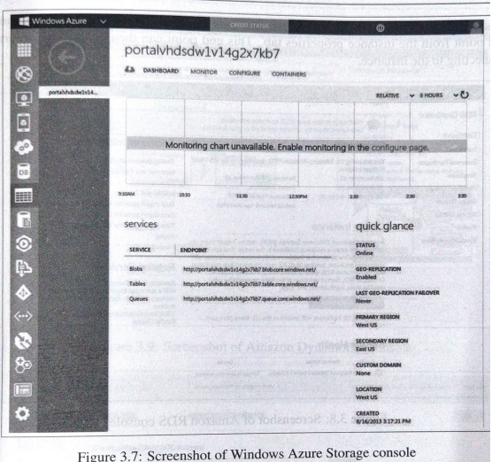

Slide 19
Features of Amazon S3
1. Storage classes
Amazon S3 offers a range of storage classes designed for different use cases
For example, you can store mission-critical production data in S3 Standard for frequent access, save costs by storing infrequently accessed data in S3 Standard-IA
Archive data at the lowest costs in S3 Glacier Instant Retrieval, S3 Glacier Flexible Retrieval, and S3 Glacier Deep Archive
You can store data with changing or unknown access patterns in S3 Intelligent-Tiering

Slide 20
2. Storage management
Amazon S3 has storage management features that you can use to manage costs, meet regulatory requirements, reduce latency, and save multiple distinct copies of your data for compliance requirements
S3 Lifecycle – Configure a lifecycle policy to manage your objects and store them cost effectively throughout their lifecycle.
S3 Object Lock – Prevent Amazon S3 objects from being deleted or overwritten for a fixed amount of time or indefinite
S3 Replication – Replicate objects and their respective metadata and object tags to one or more destination buckets in the same or different AWS Regions
S3 Batch Operations – Manage billions of objects at scale with a single S3 API request or a few clicks in the Amazon S3 console

Slide 21
3. Access management
Amazon S3 provides features for auditing and managing access to your buckets and objects. Default access –Private
S3 Block Public Access –By default, Block Public Access settings are turned on at the account and bucket level.
AWS Identity and Access Management (IAM) – Create IAM users for your AWS account to manage access to your Amazon S3 resources
Bucket policies – Use IAM-based policy language to configure resource-based permissions for your S3 buckets and the objects in them
Amazon S3 access points – Configure named network endpoints with dedicated access policies to manage data access at scale for shared datasets
Access control lists (ACLs) – Grant read and write permissions for individual buckets and objects to authorized users
S3 Object Ownership – Disable ACLs and take ownership of every object in your bucket, simplifying access management for data stored in Amazon S3
Access Analyzer for S3 – Evaluate and monitor your S3 bucket access policies

Slide 22
4. Data processing
To transform data and trigger workflows to automate a variety of other processing activities at scale, following features can be used:
S3 Object Lambda – Add your own code to S3 GET requests to modify and process data as it is returned to an application. Filter rows, dynamically resize images, redact confidential data, and much more.
Event notifications – Trigger workflows that use Amazon Simple Notification Service (Amazon SNS), Amazon Simple Queue Service (Amazon SQS), and AWS Lambda when a change is made to your S3 resources.

Slide 23
5. Storage logging and monitoring
Amazon S3 provides logging and monitoring tools that you can use to monitor and control how your Amazon S3 resources are being used
i) Automated monitoring tools:
Amazon CloudWatch metrics for Amazon S3 – Track the operational health of your S3 resources and configure billing alerts
AWS CloudTrail – Record actions taken by a user, a role, or an AWS service in Amazon S3. CloudTrail logs provide you with detailed API tracking for S3 bucket-level and object-level operations
ii) Manual monitoring tools:
Server access logging – Get detailed records for the requests that are made to a bucket. You can use server access logs for many use cases, such as conducting security and access audits
AWS Trusted Advisor – Evaluate your account by using AWS best practice checks to identify ways to optimize your AWS infrastructure, improve security and performance, reduce costs, and monitor service quotas.

Slide 24
6. Analytics and insights
Amazon S3 Storage Lens – Understand, analyze, and optimize your storage. S3 Storage Lens provides 29+ usage and activity metrics and interactive dashboards to aggregate data for your entire organization, specific accounts, AWS Regions, buckets
Storage Class Analysis – Analyze storage access patterns to decide when it's time to move data to a more cost-effective storage class
3 Inventory with Inventory reports – Audit and report on objects and their corresponding metadata and configure other Amazon S3 features to take action in Inventory reports.
7. Strong consistency
Amazon S3 provides strong read-after-write consistency for PUT and DELETE requests of objects in your Amazon S3 bucket in all AWS Regions

Slide 25
S3 – How it works?
Amazon Simple Storage Service (Amazon S3) is an object storage service offering industry-leading scalability, data availability, security, and performance
Customers of all sizes and industries can store and protect any amount of data for virtually
With cost-effective storage classes and easy-to-use management features, you can optimize costs, organize data, and configure fine-tuned access controls to meet specific business, organizational, and compliance requirements
To store your data in Amazon S3, you first create a bucket and specify a bucket name and AWS Region. Then, you upload your data to that bucket as objects in Amazon S3. Each object has a key (or key name), which is the unique identifier for the object within the bucket.

Slide 26
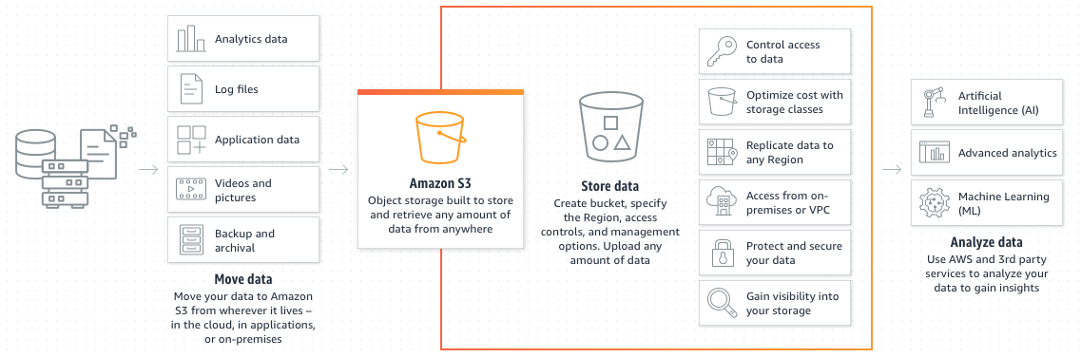

Slide 27
Buckets: A bucket is a container for objects stored in Amazon S3. You can store any number of objects in a bucket and can have up to 100 buckets in your account.
Objects: Objects consist of object data and metadata. The metadata is a set of name-value pairs that describe the object. These pairs include some default metadata, such as the date last modified, and standard HTTP metadata
Keys: An object key (or key name) is the unique identifier for an object within a bucket. Every object in a bucket has exactly one key. The combination of a bucket, object key, and optionally, version ID (if S3 Versioning is enabled for the bucket) uniquely identify each object
S3 Versioning: You can use S3 Versioning to keep multiple variants of an object in the same bucket
Version ID: When you enable S3 Versioning in a bucket, Amazon S3 generates a unique version ID for each object added to the bucket. Objects that already existed in the bucket at the time that you enable versioning have a version ID of null.

Slide 28
Database Services -DBaaS
Allows to set up and operate relational or non-relational database in cloud
It relieves the application developers from time consuming database administration tasks
Popular relational databases provided by various cloud service providers include MySQL, Oracle, SQL Server etc.
Non-relational (No-SQL) databases provided by cloud service providers are mostly proprietary solutions
Cloud provider takes care of everything from periodic upgrades to backups for 24/7

Slide 29
What is Database?
Data is an information about an object along with metadata(the data providing information about one or more aspects of the data)
Object can be anything that is real and can be defined using different attributes
A Database is a collection of organized data, information and records
DBMS: Database Management that creates and manages databases
Platform: SQL (MySQL – free & open source)

Slide 30
Types of Database
Relational Database
Stored in table/s (rows & columns)
Schema is fixed
Does not perform well for variable schema
Vertical scaling possible
Non-Relational Database
Schema not fixed
Key-value stores (fast & provides quick access)
Supports heavy read/write

Slide 31
DBaaS Features
Scalability: allows provisioning as much compute and storage resources as required to meet the application workload levels
Reliability: provides automated backup and snapshot options
Performance: provides guaranteed performance with options such as input/output operations per second (IOPS)
Security: provides several security features to restrict the access to the database instances and stored data such as network firewalls and authentication mechanisms.

Slide 32
Benefits
Cost savings
Up/down scaling
Simple management
Rapid development and faster time to market
Encrypted data and application security
Reduced risk
Software quality

Slide 33
Amazon Relational Data store
RDS is amazon relational database service
Easy to set up, operate and scale a relational database in cloud
Console provides an instance launch wizard that allows you to select type of database to create (MySQL, Oracle or SQL server) database instance size, allocated storage, DB instance identifier, DB username and password

Slide 34
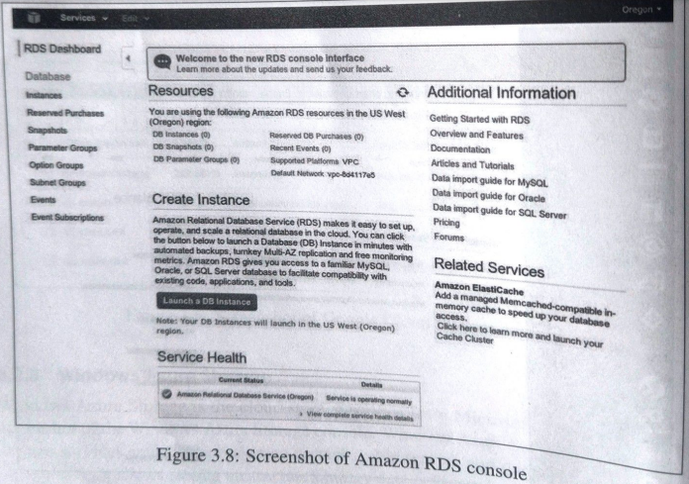

Slide 35
Amazon DynamoDB
Amazon non-relational database service
DyanamoDB data model includes include table, items and attributes
To store data in DynamoDB , you have to create one or more tables and specify how much throughput capacity you want to provision and reserve for reads/writes
Fully managed service that automatically spreads the data and traffic for the stored tables over number of servers to meet the throughput requirements specified by users

Slide 36
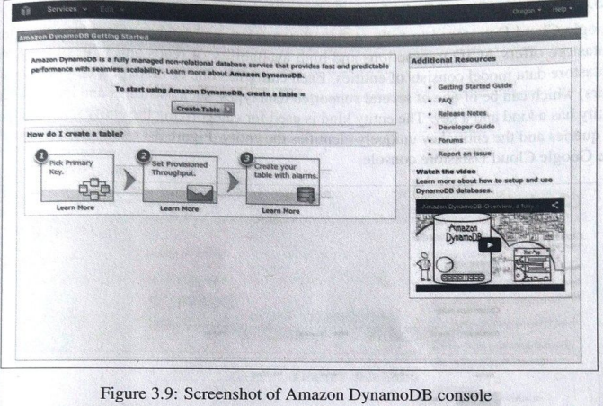

Slide 37
Google cloud SQL
Relational database service from Google
Allows you to host MySQL databases in Google’s cloud
Google cloud SQL also provides synchronous & asynchronous replication services
Supports ability to import/ export databases
To create instance- Select region – Select database tier – billing plan – replication mode
Daily backups can be scheduled in Google cloud

Slide 38
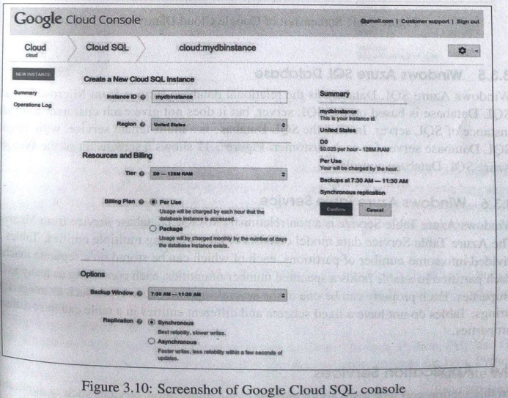

Slide 39
Google cloud datastore
Fully managed non-relational database by Google
It offers ACID (Atomicity, Consistency, Isolation, Durability) transactions and high availability of read/write
Datastore model consist of entities
Each entity has one or more properties (Key-value pair)

Slide 40
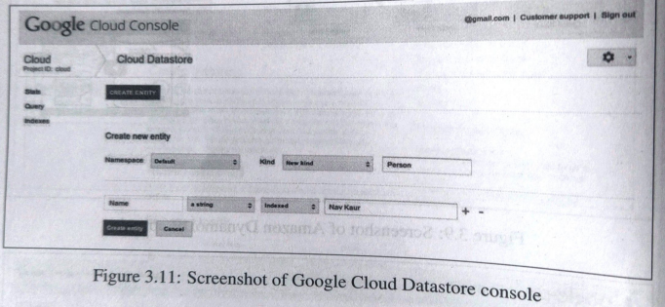

Slide 41
Windows Azure SQL database
Relational database service from Microsoft
It does not provide each customer a separate instance of SQL server
Instead SQL database is multi-tenant service with logical SQL database server for each customer

Slide 42
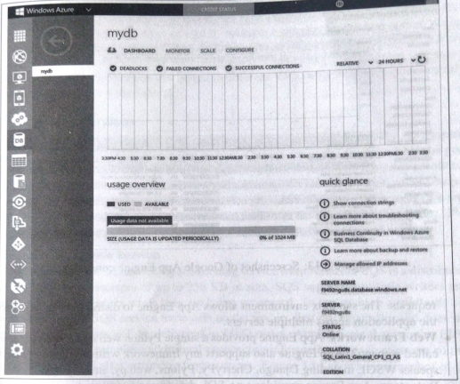

Slide 43
Windows Azure Table Service
Non-relational (No-SQL) database service by Microsoft
This mode consist of tables having multiple entities
Tables are divided into some number of partitions, each of which can be store in separate machine
Each partition in table holds a specified number of entities, each containing several properties
Each property can be one of the several supported data types
Tables do not have fixed schema and different entities in a table can have different properties

Slide 44
Application Services
Application runtime and frameworks
Queuing services
Email services
Notification services
Media services

Slide 45
1. Application Runtime & Frameworks
Allows developer to develop and host applications in the cloud
Provide support for programming languages like java, python, ruby etc.
Application runtime automatically allocate resources for applications and handle application scaling

Slide 46
Google App Engine
Provides PaaS and includes both application runtime & web framework.
Features:
Runtime: It supports applications developed in Java, Python, PHP and Go programming languages
Sandbox: Application run in secure sandbox environment isolated from other applications. Sandbox provides limited access to underlying OS. Distributes web requests for application across multiple servers.
Web frameworks: It provides simple python web application framework called Webapp2. It also supports any framework written in pure python that speaks WSGI, including django, cherryPy, Pylons, web.py etc.

Slide 47
Datastore: No SQL data storage service
Authentication: App Engine applications can be integrated with Google accounts for user authentication
URL Fetch service: It allows applications to access resources on the internet
Email services: Allows applications to send email messages
Image manipulation service: Allows applications to resize, crop, rotate, flip and enhance images
Memcache: High performance in-memory key-value cache service that applications can use for caching data items that do not need a persistent storage
Task Queues: Allows applications to do work in the background by breaking up work into small, discrete units, called taks which are enqueued in task queues
Scheduled Tasks service: App Engine provides a Cron service for scheduled tasks that trigger events at specified times and regular intervals.

Slide 48
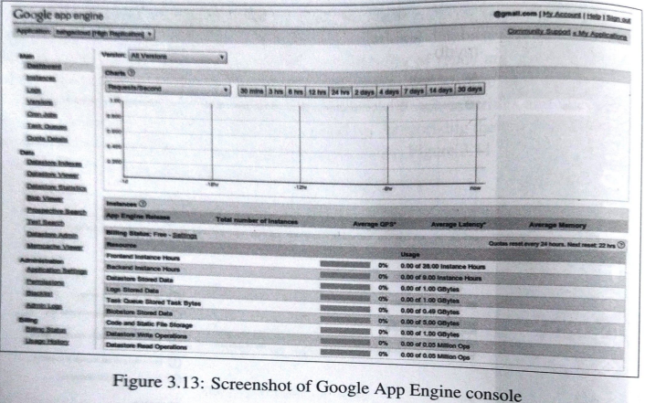

Slide 49
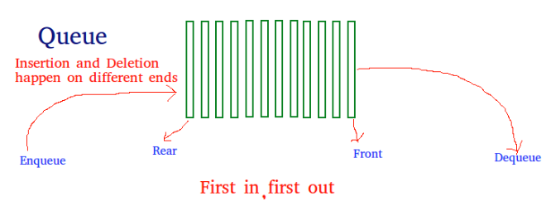
2. Queueing Services
What is Queue?
A Queue is a linear structure which follows a particular order in which the operations are performed
The order is First In First Out (FIFO)

Slide 50
Cloud based queuing services allow de-coupling application components
De-coupled components communicate via messaging queues
Queues are used for asynchronous processing
Queues also act as overflow buffers to handle temporary volume spikes or mismatches in message generation and consumption rates from application components
Queuing services from various cloud service provider allow short messages of a few kilo-bytes in size
Message can be enqueued and read from the queues simultaneously

Slide 51
Amazon Simple Queue Service
SQS is queuing service by Amazon
It is distributed queue that supports messages of up to 256 KB in size
SQS supports multiple writers & readers and locks messages while they are being processed
SQS service trade-offs on FIFO capability and does not guarantee that message will be delivered in FIFO order
Application that requires FIFO ordering of messages can place additional sequencing information in each message so that they can re-0rdered after retrieving from queue

Slide 52
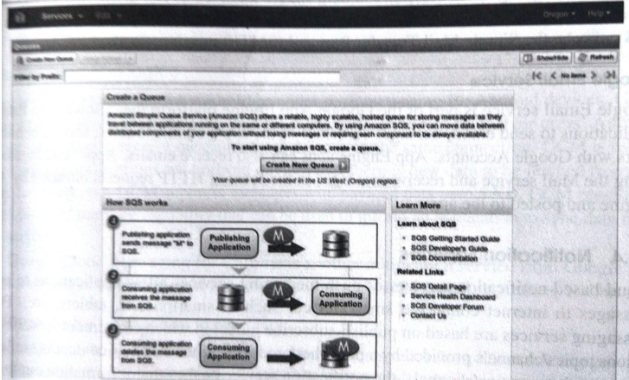


Slide 53
Google Task Queue service
Queuing service from Google
It is part of Google App Engine platform
Task Queues allow applications to execute tasks in background
There are two different configurations for Task Queues-
- Push Queue
- Pull Queue
Push queue is default queue that processes tasks based on processing rate
Pull queues allow task consumers to lease a specific number of tasks for a specific duration. The tasks are processed and deleted before the lease ends

Slide 54
Windows Azure Queue Service
Queuing service by Microsoft
It allows storing large number of messages that can be accessed from anywhere in the world via authenticated calls using http or https
Size of single message can be 64 KB

Slide 55
3. Email Services

Slide 56
Amazon Simple Email service
It is bulk and transactional email-sending service from Amazon
It is outbound-only
To ensure high email deliverability, SES uses content filtering technologies to scan the outgoing email messages
SES can be accessed and used from SES console, Simple Mail Transfer Protocol (SMTP) interface or SES API

Slide 57
Google Email Service (Gmail)
Part of Google App Engine platform that allows App Engine applications to send email messages
App engine can also receives emails

Slide 58
4. Notification Services
Cloud based notification services or push messaging services allow applications to push messages to internet connected smart devices
Push messaging services are bases on publish-subscribe model
Topic /Channel provided by publisher/producer
Consumers subscribe for the Topic/Channel
For new contents or intimations, messages are pushed on Topic/Channel
Consumer applications on smart devices can increase their consumer engagement with the help of push notifictions

Slide 59
Amazon Simple Notification Service (SNS)
Fast and fully managed Push messaging service from Amazon
SNS has two types of clients – Publisher & Subscriber
Publishers communicate asynchronously with subscribers by producing and sending messages to topics
Topic is a logical access point and communication channel (Each topic has unique name within an account, Each topic assigned with ARN)
Subscribers are the consumers who subscribe to topics to receive notifications
SNS can deliver notifications as SMS, email or to SQS queues or http endpoint
SNS console has wizards for creating a new topic, publishing to a topic and subscribing to a topic

Slide 60
Continue..
Can send message to single user or to multiple users
There is no upfront cost for the service, pay per use
Reliable
Messages can be transmitted using multiple protocol schemes
Access policies can be defined

Slide 61
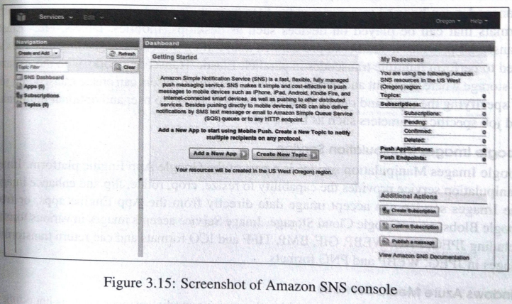

Slide 62
Google Cloud Messaging
Google cloud messaging for Android provides push messaging for Android devices
It allows applications to send data from application servers to their users and android devices
GCM is useful for applications on Android devices that there is new data to be fetched from the application servers
GCM provides ‘send-to-sync’ message capability that can be used to inform an application to sync data from server
GCM supports messages with payload data upto 4KB

Slide 63
Windows Azure Notification Hubs
Push notification service from Microsoft that provides a common interface to send notifications to all major mobile platforms
Platform specific infrastructure called Platform Notification Systems (PNS) are used to deliver notification messages
Devices register their PNS handles with Notification Hub
Each notification hub contains credentials for each supported PNS
These credentials are used to connect to PNS and send push notifications to the applications.

